Slide 1
STARFISH for FACULTY
Student INFORMATION SUPPORT, Office of the President

Slide 2
What is Starfish?
Student Success platform that supports Guided Pathways
  Connects students to support services
  Empowers CAP Success Teams
  Provides a unified view of student progress
  Keeps faculty in the loop

Slide 3
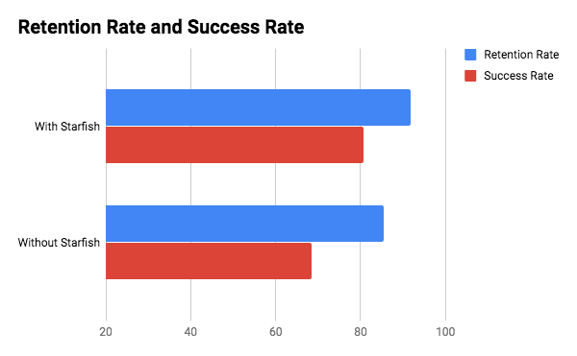
In Good Company
Forty-five other CCCs
Pasadena ‘17-’18:

Slide 4
SAC Tracking Items
Flags
Referrals
Attendance Concern
Academic Concern
Non-academic Concern
In Danger of Failing
Counseling
DSPS
Financial Aid
Health Center
Tutoring

Slide 5
Lift Students Up w/ Positive Feedback
KUDOS
  Keep up the good work!
  Showing improvement!
  Thank you!

Slide 6
Top Five: Most Raised Tracking Items
Name |  | # Raised
Keep Up the Good Work |  | 6316
Academic Concern (Credit) |  | 2194
Tutoring Referral |  | 695
Attendance Concern |  | 600
Non-Academic Concern |  | 342

Slide 7
Ways to Use Starfish
Respond to progress surveys
Manually enter a flag / referral or kudo
Track when items are closed

Slide 8
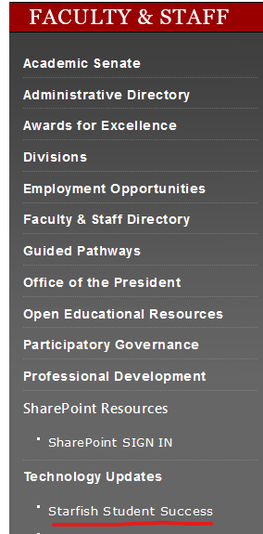
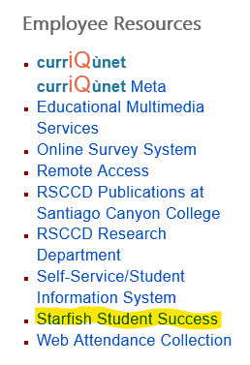
For More Info. & To Login

